Slide 1
Exploring and building cross-platform TUIs
Andrew Pla

Slide 2



Who am i?
Father of 2 living on Gainesville, FL.
PowerShell Advocate
Co-Host PowerShell Podcast
2018 Summit Scholarship winner
Notes:
Shoutout to my awesome cohost, Jordan.

Slide 3
Goal
Show off TUIs in PowerShell and how to build your own.

Slide 4
Plan
TUI Basics
Terminal.GUI
Example Projects
Develop a Simple TUI
Advanced features/controls
Next steps…

Slide 5

What and why TUIs
A TUI (Text-Based User Interface) is a user interface that uses text instead of graphics.
Been around for a long, long time
Lightweight, fast, and efficient.
Quite fun and nostalgic
GUI isn’t always available
You already spend your life in the terminal, why not make it better
Less context-switching

Slide 6
TUIs and PowerShell
Great talk last year about by Mark Wilkinson about writing your own CLI tools with PowerShell
https://www.youtube.com/watch?v=Zbg82AvYqaY
Covers some of the challenges of developing a TUI and how to deal with things like $Host, looping, and more
Valid approach, but I’m lazy
Notes:
- Talk covered SQLTOP

Slide 7

What Is Terminal.gui
Toolkit for building rich console apps for .NET, .NET Core, and Mono that works on Windows, the Mac, and Linux/Unix.
.NET Core, runs on Windows, Linux, and MacOS
Create TUIs quickly and easily using PowerShell, without needing to learn complex UI frameworks.
Thanks to Adam Driscoll for creating some great resources and introducing this to the PowerShell community.
Notes:
and provides a set of functions for creating and managing TUI widgets.
Switch to What is Terminal.GUI
- Simple example of a dialog

Slide 8
Microsoft.PowerShell.ConsoleGuiTools
Built with Terminal.GUI
Great way to start building TUI tools.
Out-ConsoleGridView
Out-GridView, but in the terminal
Use F7 as "Show Command History" in Powershell
https://github.com/gui-cs/F7History
Show some code!
Notes:
PowerShell is pretty amazing, so just having a graphical way to filter and view data is really helpful!
Show “Out-ConsoleGridView examples.ps1”
This is what I love, rethining our tools and our workflow. There have been a lot of improvements over the years to the tools that we have available, like PSReadline.
Great way to improve our workflow, tying this together with PSReadline is very powerful. There is potential for some more comprehensive projects, but at the least I hope that this inspires people to create

Slide 9
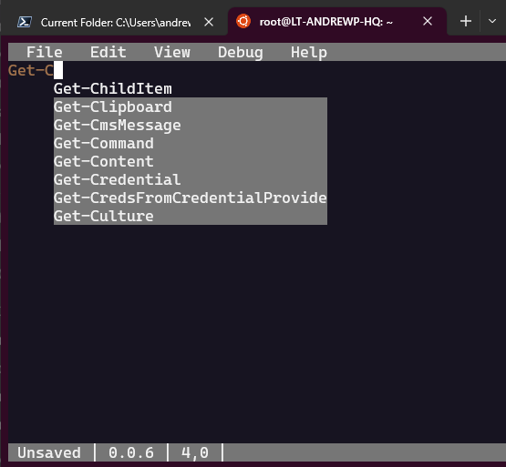
PSEdit
Don’t leave your Terminal to edit your code!
Uses Terminal.GUI
Shoutout Adam Driscoll
Install-Module PSEdit

Slide 10
PSEdit features
IntelliSense
Syntax Higlighting
Format on Save
Script Execution
Error View
Syntax Error View
https://github.com/ironmansoftware/psedit

Slide 11

Setup
Easiest way to get it installed is to download Microsoft.PowerShell.ConsoleGuiTools
Install-Module Microsoft.PowerShell.ConsoleGuiTools
Ships the .dll files that we need
Terminal.Gui.dll
If developing in VS Code, use this code so that Ctrl + Q isn’t captured by VS Code:
https://github.com/microsoft/vscode/issues/108130
Notes:
Show starter.ps1

Slide 12
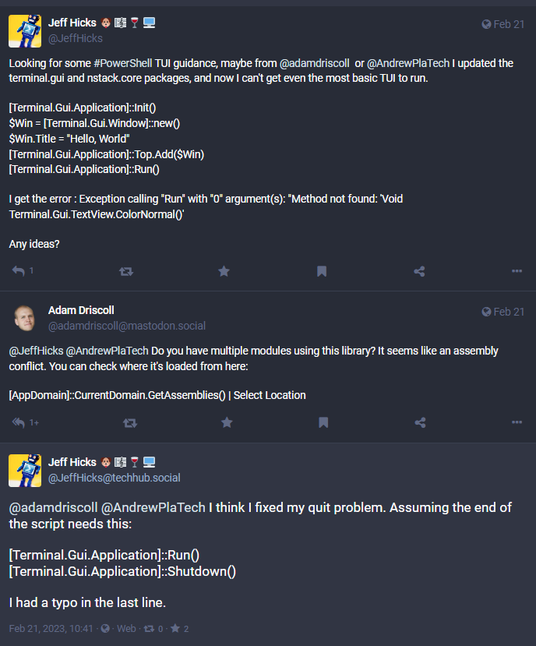
Make sure to shutdown
Notes:
You want the application to cleanup when it’s done and you can run into other issues. Make sure to not forget
Shutdown() is what cleans things up and returns your console to you. If you don’t do that, it gets messy.

Slide 13
TerminalGuiDesigner
https://github.com/ironmansoftware/terminal-gui-designer
Thanks to Adam Driscoll
Show-TuiDesigner
Alternative method to designing your TUIs

Slide 14
Using Show-TuiDesigner
Drag and Drop is nice sometimes
Known issue, where you need to run [Terminal.Gui.Application]::Init() before calling Show-TuiDesigner
https://github.com/ironmansoftware/terminal-gui-designer/issues/1

Slide 15

Basic code and examples
See code

Slide 16
Out-TreeView
View complex objects in a tree view
Uses Terminal.GUI
Adam Driscoll https://blog.ironmansoftware.com/daily-powershell/powershell-out-tree-view/
Notes:
Same code as Adam Driscoll, with a few tweaks, like adding [Terminal.Gui.Application]::Shutdown() to Out-TreeView, still plenty of more room for improvement.
Out-TreeView examples.ps1

Slide 17
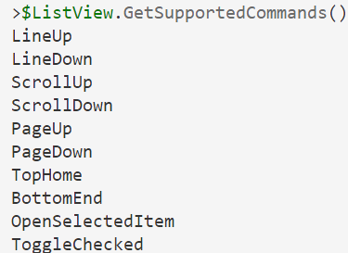
Views
All visible elements are views, it is the base class for all views.
A view can contain zero or more nested views, or Subviews.
You can add views to existing views by calling the Add method.
Tip: use the GetSupportCommands() to see which commands are implemented by whatever view you are using

Slide 18
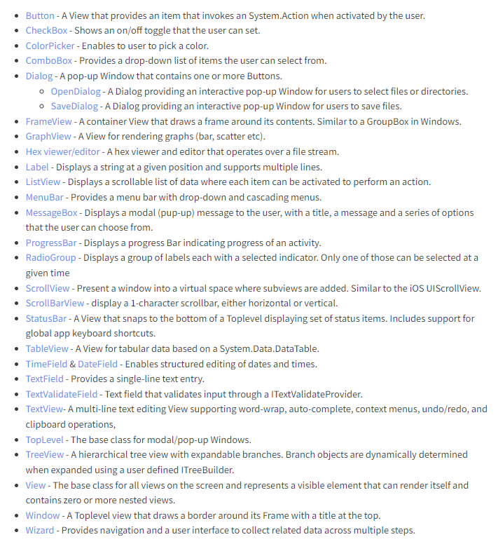
Examples of Views

Slide 19
TopLevel
Common view
Has subclasses of Window and Dialog
Window extends the Toplevel view and gives it a frame and a title
Could have multiple windows on screen
Dialogs are windows that are centered and run modally
No visible UI
Can be used to launch a new experience in your application
Can be initialized with [Terminal.Gui.Application]::Init()
Add a window to the top view using
[Terminal.Gui.Application]::Top.Add($Window)

Slide 20
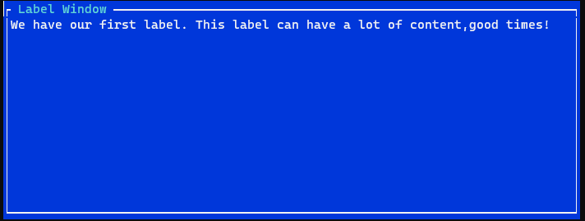
Labels
Text for your views, the content
Notes:
Labels.ps1
https://gui-cs.github.io/Terminal.Gui/api/Terminal.Gui/Terminal.Gui.Label.html

Slide 21
Layout
Putting things in the right place is a big part of designing
Spacing and formatting can be tricky
Terminal.Gui supports two different layout systems, controlled by the LayoutStyle property on the view
Absolute – Manually control the view
Computed – automatic centering, expanding dimensions, etc.
Notes:
Checkout Frames1.ps1

Slide 22
Pos type - position
Allows setting the position of your views
Can pass an integer for absolute positioning
Can make it a percentage of the parent’s view size
Centered
Can reference the positions of other views
Lets you put views in positions relative to each other

Slide 23
Dim type
What is dim?
Dim.. Sum?
Diminished
Diminutive
…. DIMENSION
Width and height on a view
Absolute size
Percentage of parent view
Fill it!

Slide 24
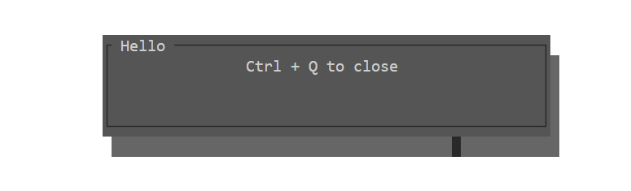
Dialog
A window that is centered and contains one or more buttons
Can be run modally
Notes:
Dialogs.ps1

Slide 25
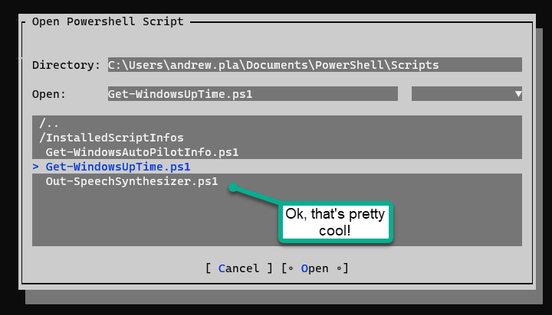
File Dialogs
Useful to both Open and Save files
Good UX with minimal code
How many lines of code would it take you to design and implement this interface?
Notes:
File Dialogs.ps1

Slide 26
Keyboard Input Handling
Every view has a focused view and only one view can have focus.
You can use tab and shift+tab to move between views
Keyboard processing goes like this
Hotkey processing
Regular Processing - Key is sent to normal view
Cold Key Processing
Esc, return key with a default action.
Read more: https://gui-cs.github.io/Terminal.Gui/articles/keyboard.html
Notes:
Every view has a focused view, and if that view has nested views, one of those is the focused view. This is called the focus chain, and at any given time, only one View has the focus.
The library binds the key Tab to focus the next logical view, and the Shift-Tab combination to focus the previous logical view.
Keyboard processing is divided in three stages: HotKey processing, regular processing and cold key processing.
Hot key processing happens first, and it gives all the views in the current toplevel a chance to monitor whether the key needs to be treated specially. This for example handles the scenarios where the user pressed Alt-o, and a view with a highlighted "o" is being displayed.
If no view processed the hotkey, then the key is sent to the currently focused view.
If the key was not processed by the normal processing, all views are given a chance to process the keystroke in their cold processing stage. Examples include the processing of the "return" key in a dialog when a button in the dialog has been flagged as the "default" action.
The most common case is the normal processing, which sends the keystrokes to the currently focused view.
Mouse events are processed in visual order, and the event will be sent to the view on the screen. The only exception is that no mouse events are delivered to background views when a modal view is running.
More details are available on the Keyboard Event Processing document.

Slide 27
Key Bindings
Rebind keys
Use AddKeyBinding to add
Notes:
Terminal.Gui supports rebinding keys. For example the default key for activating a button is Enter. You can change this using the ClearKeybinding and AddKeybinding methods:
var btn = new Button ("Press Me"); btn.ClearKeybinding (Command.Accept); btn.AddKeyBinding (Key.b, Command.Accept); The Command enum lists generic operations that are implemented by views. For example Command.Accept in a Button results in the Clicked event firing while in TableView it is bound to CellActivated. Not all commands are implemented by all views (e.g. you cannot scroll in a Button). To see which commands are implemented by a View you can use the GetSupportedCommands() method.
Not all controls have the same key bound for a given command, for example Command.Accept defaults to Key.Enter in a Button but defaults to Key.Space in RadioGroup.
Global Key Handler
Sometimes you may want to define global key handling logic for your entire application that is invoked regardless of what Window/View has focus. This can be achieved by using the Application.RootKeyEvent event.

Slide 28
Developing in VS Code
Ctrl + Q to escape won’t work, use this
# https://github.com/microsoft/vscode/issues/108130
"terminal.integrated.commandsToSkipShell": [
"-workbench.action.quickOpenView"
]

Slide 29
Events and the mainloop
Application.Run is responsible for waiting for events and routing them to the proper view.
[Application]::MainLoop.Invoke({}) is responsible for updating the UI from the background thread.

Slide 30
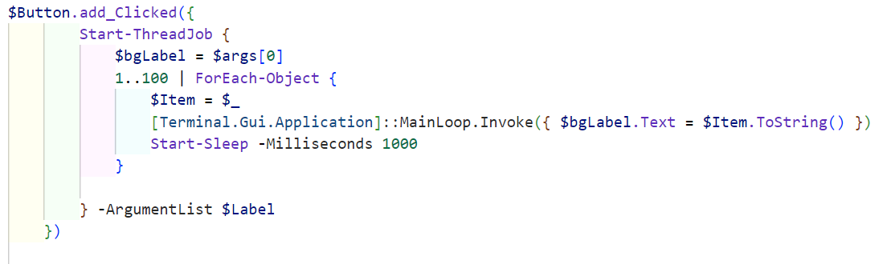
Clicking buttons
Add_Clicked method

Slide 31
Threading
Notes:
Open AsyncExecution

Slide 32
Keyboard Events
Add_KeyPress
Similar to Add_Clicked
Notes:
AddKeypress.ps1

Slide 33
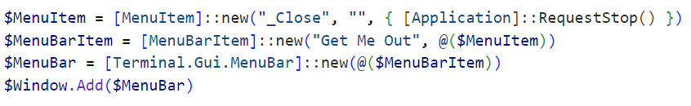
Menu
Menus can be created by combining
MenuItem
MenuBarItem
And a MenuBar
https://gui-cs.github.io/Terminal.Gui/api/Terminal.Gui/Terminal.Gui.MenuItem.html
HotKeys are defined by prefixing the Title of a MenuItem with an underscore _

Slide 34
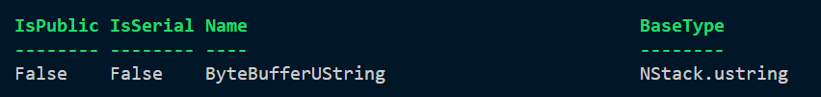
Nstack.Ustring Challenges
Instead of [String], some text properties are saved as [Nstack.ustring]
To get the text from these, use the .tostring() method
$($dialog.FilePath.ToString())
Read more: https://stackoverflow.com/questions/64178641/how-to-add-an-event-action-handler-in-powershell/64232782#64232782
Notes:
Show the

Slide 35
What next
I hope that you take what you’ve seen today and take things forward.
Would love more TUIs in the PowerShell world
Make something useful, let’s collaborate!
Read the docs to discover more
https://github.com/gui-cs/Terminal.Gui
https://blog.ironmansoftware.com/tui-powershell
https://gui-cs.github.io/Terminal.Gui/index.html

Slide 36
Thanks
Thanks for coming and thanks to the sponsors.
@AndrewPlaTech

